Slide 1
UNIT -3

Slide 2
Find S Algorithm: Most Specific to most general hypothesis
It is the most basic learning algorithm in Machine learning
Find S finds the most specific hypothesis that fits for all positive examples. (Algorithm Considers only positive examples).
Find S starts with most specific hypothesis and generalizes this hypothesis each time it fails to classify an observed positive training example.

Slide 3
Algorithm
Start with the most specific hypothesis. h = {ϕ, ϕ, ϕ, ϕ, ϕ, ϕ}
Take the next example and if it is negative, then no changes occur to the hypothesis.
If the example is positive and we find that our initial hypothesis is too specific then we update our current hypothesis to general condition.
Keep repeating the above steps till all the training examples are complete.
After we have completed all the training examples we will have the final hypothesis when can used to classify the new examples.

Slide 4
Hypothesis Representation
Hypothesis Points to the values of the attributes in the dataset
? Indicates any value accepted by attribute
Φ indicates no value accepted by attribute
Most general Hypothesis is (?,?,?,?,….)
Most Specific Hypothesis is (ϕ, ϕ, ϕ……)

Slide 5
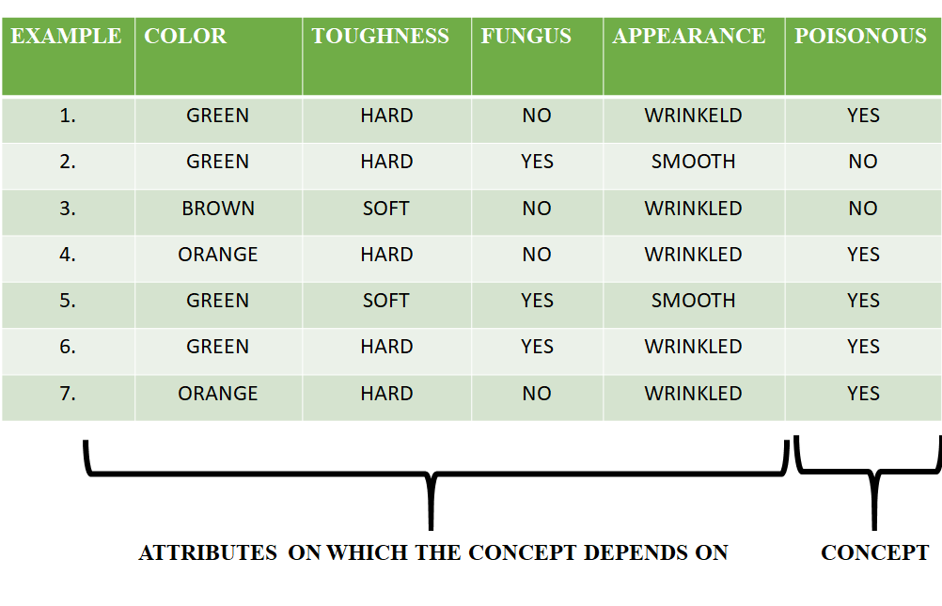

Slide 6
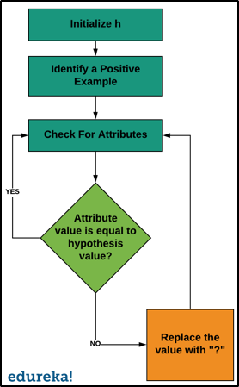
Flowchart for Find S

Slide 7
Steps of Solution
h = {ϕ, ϕ, ϕ, ϕ, ϕ, ϕ}
For sample 1, h = { GREEN, HARD, NO, WRINKLED }
For sample 4, h = { ?, HARD, NO, WRINKLED }
For sample 5, h = { ?, ?, ?, ? }
No need to consider 6 and 7 samples.

Slide 8
Introduction
We know that planning about future is very necessary for the every business firm, every govt. institute, every individual and every country.
Time Series data can be found in many applications economics, social sciences, finance, epidemiology, and the physical sciences.

Slide 9
Analysis of Time Series
It is a statistical technique deals with time series data and trend analysis.
Time Series data means data in a particular time periods or intervals.
Time series data is data that is collected at different points in time.
Data points in time series are collected at adjacent time periods there is potential for correlation between observations.
Example : Global air pollution from the Countries, unemployment rates in India etc

Slide 10
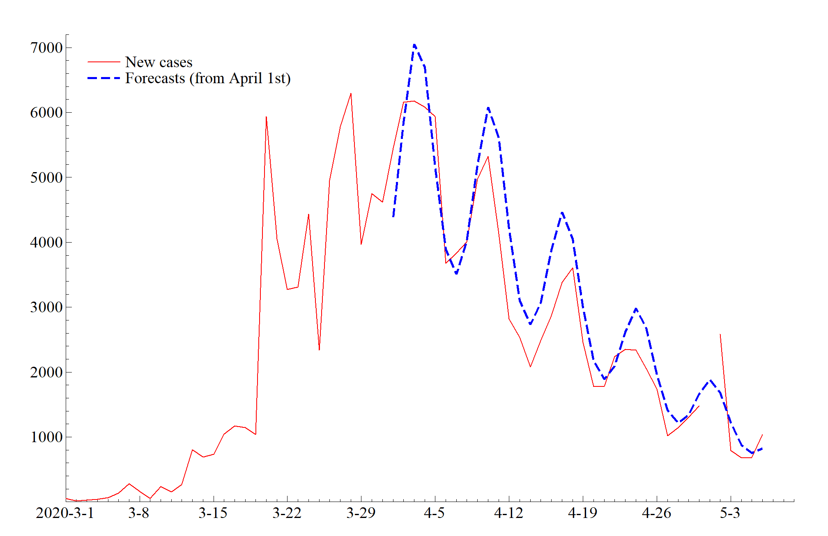

Slide 11
Mathematical presentation of Time series
A time series is set of observation taken at specified times, usually at equal intervals
Mathematically a time series is defined by the values Y1, Y2, ….Yn of variable Y at times t1,t2,…,tn
Y=f(t)

Slide 12
Objectives of Time series analysis
To describe the important features of the time series pattern
To explain how the past affects the future or how two time series can “interact”.
To forecast future values of the series.
To possibly serve as a control standard for a variable that measures the quality of product in some manufacturing situations.

Slide 13
Importance of Time Series Analysis
A popular tool for Business forecasting
Basis for understanding past behaviour
Can forecast future activities/ Planning future operations
Evaluate current accomplishments/ evaluation of performance

Slide 14
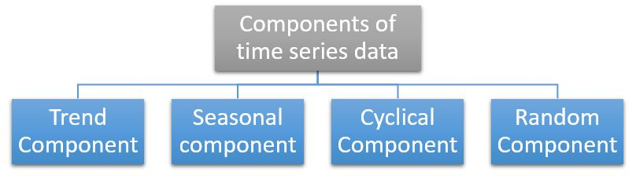
Components in Time Series
Trend
Seasonal Variations
Cyclic variations
Irregular variations

Slide 15
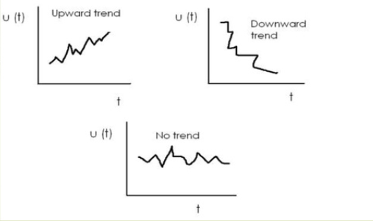
Trend
General tendency of data to grow or decline over a long period of time
The forces which are constant over a long period produce the trend.

Slide 16
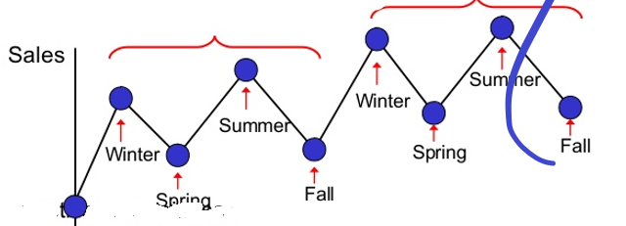
Seasonal Variations
The component responsible for regular rise or fall in the time series during a period not more than 1 year.
Fluctuations occur in regular sequence
The term seasonal is meant to include any kind of variation which is of periodic nature and whose repeating cycles are of relatively short duration
The factors of seasonal variations are (a) Climate & weather condition b) custom traditions and habits

Slide 17
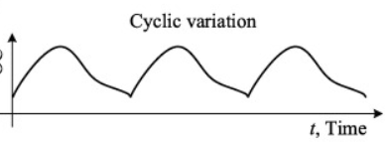
Cyclic Variations
Cycle refers to recurrent variations in time series
Cyclical variations usually last longer than a year
Cyclic fluctuations are long term movements that represent consistently recurring and declines in activity

Slide 18
Irregular variation
This is called called erratic, random or accidental variations.
Do not repeat in a definite pattern
Unpredictables -Strikes, fire,wars, floods, earth quakes

Slide 19
Mathematical models- Additive model
The data is the sum of the time series components
Y_{i}=T+S+C+I
There will be no cyclic component for short term data
Y_{i}=T+S+I

Slide 20
Multiplicative model
The data is product of various values
Y_{i}=T*S*C*I

Slide 21
Linear Time Series Analysis
Linear time series analysis provides a natural framework to study the dynamic structure of such a series.
The theories of linear time series discussed include stationarity, dynamic dependence, autocorrelation function, modeling, and forecasting.

Slide 22
Simple Autoregressive (AR)
Autoregression is a time series model that uses observations from previous time steps as input to a regression equation to predict the value at the next time step.
A regression model, such as linear regression, models an output value based on a linear combination of input values.
yhat = b0 + b1*X1
This technique can be used on time series where input variables are taken as observations at previous time steps, called lag variables.
X(t+1) = b0 + b1*X(t-1) + b2*X(t-2)

Slide 23

Simple moving-average (MA) models
The forecast for the value of Y at time t+1 that is made at time t equals the simple average of the most recent m observations:
This average is centered at period t-(m+1)/2, which implies that the estimate of the local mean will tend to lag behind the true value of the local mean by about (m+1)/2 periods.
Thus, we say the average age of the data in the simple moving average is (m+1)/2 relative to the period for which the forecast is computed: this is the amount of time by which forecasts will tend to lag behind turning points in the data.

Slide 24
Auto-Regressive Integrated Moving Average
An ARIMA model can be understood by outlining each of its components as follows:
Autoregression (AR): refers to a model that shows a changing variable that regresses on its own lagged, or prior, values.
Integrated (I): represents the differencing of raw observations to allow for the time series to become stationary, i.e., data values are replaced by the difference between the data values and the previous values.
Moving average (MA): incorporates the dependency between an observation and a residual error from a moving average model applied to lagged observations.

Slide 25
NonLinear Dynamics
Nonlinear dynamics is the branch of physics that studies systems governed by equations more complex than the linear, aX+b form.
Nonlinear systems, such as the weather or neurons, often appear chaotic, unpredictable or counterintuitive, and yet their behaviour is not random.
A nonlinear system is a system in which the change of the output is not proportional to the change of the input.
Nonlinear dynamical systems, describing changes in variables over time, may appear chaotic, unpredictable, or counterintuitive, contrasting with much simpler linear systems.
The behavior of a nonlinear system is described in mathematics by a nonlinear system of equations, which is a set of simultaneous equations in which the unknowns appear as variables of a polynomial of degree higher than one or in the argument of a function which is not a polynomial of degree one.

Slide 26
Nonlinear ordinary differential equations
Nonlinear ODEs occur in numerous forms depending on the nature of the problem.
These problems could be either Hamiltonian or dissipative.
The solution properties of the underlying nonlinear differential equations like integrability, non-integrability, chaos, localization, patterns, etc. depend upon the order of the highest derivative, number of dependent variables, degree of nonlinearity, whether homogeneous or inhomogeneous and the numerical values of the controlling parameters as well as on the initial conditions.

Slide 27
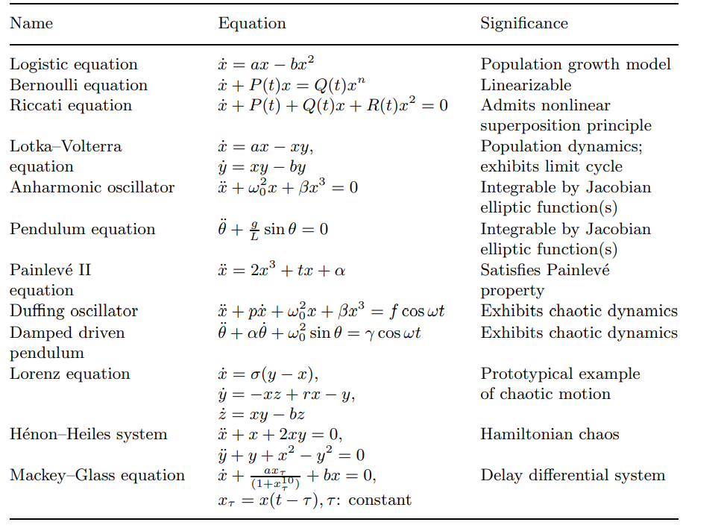
Non linear ordinary differential equations

Slide 28
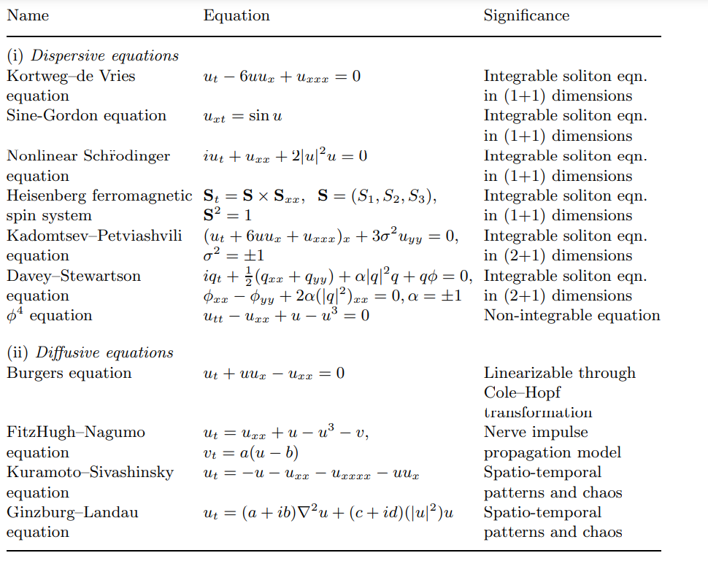
Nonlinear dynamical systems represented by partial differential equations

Slide 29
Rule Induction
Rule induction is one of the most important techniques of machine learning.
Since regularities hidden in data are frequently expressed in terms of rules, rule induction is one of the fundamental tools of data mining at the same time.
Usually rules are expressions of the form
if (attribute − 1, value − 1) and (attribute − 2, value − 2) and ··· and (attribute − n, value − n) then (decision, value)

Slide 30
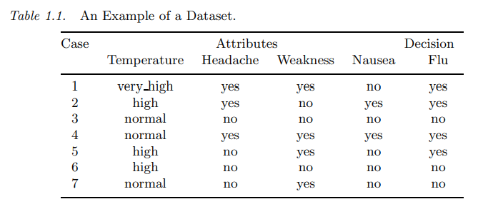
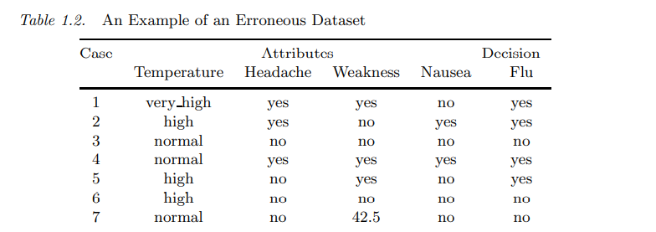
Some rule induction systems induce more complex rules, in which values of attributes may be expressed by negation of some values or by a value subset of the attribute domain

Slide 31
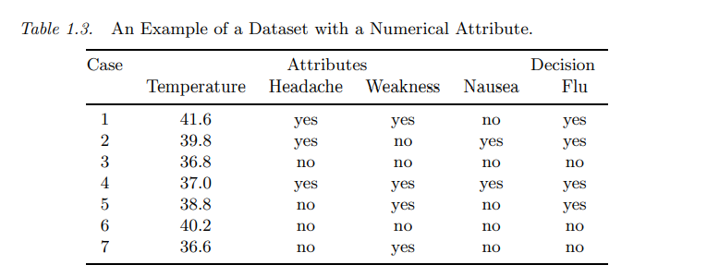
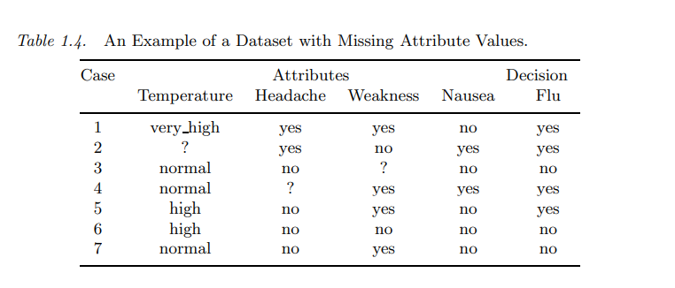

Slide 32
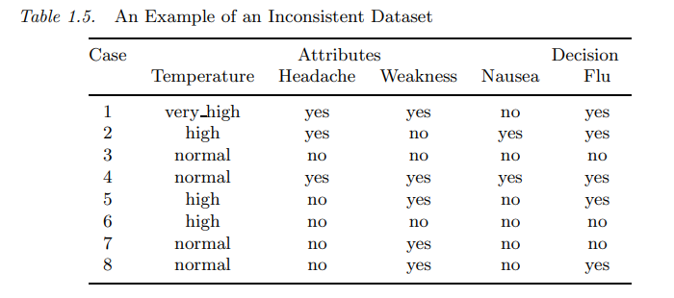
A case x is covered by a rule r if and only if every condition of r is satisfied by the corresponding attribute value for x
A concept C is completely covered by a rule set R if and only if for every case x from C there exists a rule r from R such that r covers x.
A rule r is consistent if and only if for every case x covered by r, x is a member of the concept C indicated by r. A rule set R is consistent if and only if every rule from R is consistent with the data set.

Slide 33
Rule Induction Rule Induction Using Sequential Covering Algorithm
Sequential Covering Algorithm can be used to extract IF-THEN rules form the training data.
As per the general strategy the rules are learned one at a time. For each time rules are learned, a tuple covered by the rule is removed and the process continues for the rest of the tuples.
The sequential learning Algorithm where rules are learned for one class at a time. When learning a rule from a class Ci, we want the rule to cover all the tuples from class C only and no tuple form any other class.

Slide 34
Algorithm: Sequential Covering
Input:
D, a data set class-labeled tuples,
Att_vals, the set of all attributes and their possible values.
Output: A Set of IF-THEN rules.
Method:
Rule_set={ }; // initial set of rules learned is empty
for each class c do
repeat
Rule = Learn_One_Rule(D, Att_valls, c);
remove tuples covered by Rule form D;
until termination condition;
Rule_set=Rule_set+Rule; // add a new rule to rule-set
end for
return Rule_Set;

Slide 35
Case 1: (Headache, yes) → (Flu, yes)
From cases 2,4,5 is (Headache, yes) → (Flu, yes) accepted?
Therefore it is not consistent..

Slide 36
If r is (Headache, yes)&(Weakness, yes) → (Flu, yes) &
(Temperature, high)&(Headache, yes) → (Flu, yes) is this consistent ?
case 5 is not covered by any rule.
task of rule induction is to induce a rule set R that is consistent and complete.
(Headache, yes) → (Flu, yes),
(Temperature, high)&(Weakness, yes) → (Flu, yes),
(Temperature, normal)&(Headache, no) → (Flu, no),
(Headache, no)&(Weakness, no) → (Flu, no).
is deterministic.

Slide 37
Human Brain
Humans perform complex tasks like vision, motor control, or language understanding very well.
One way to build intelligent machines is to try to imitate the human brain.
The brain is a highly complex, non-linear, and parallel computer, composed of some 10¹¹ neurons that are densely connected (~10⁴ connection per neuron).
We have just begun to understand how the brain works...
A neuron is much slower (10⁻³sec) compared to a silicon logic gate (10⁻⁹sec), however the massive interconnection between neurons make up for the comparably slow rate.
– Complex perceptual decisions are arrived at quickly (within a few hundred milliseconds)

Slide 38
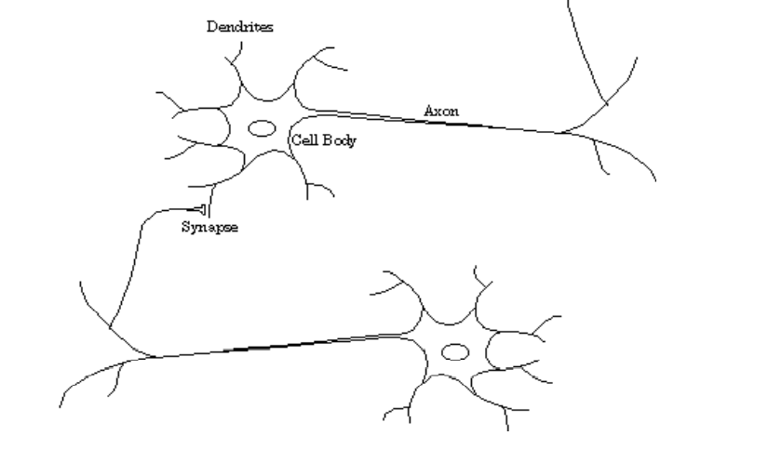
Human Brain
The interneuron connections are mediated by electrochemical junctions called synapses, which are located on branches of the cell referred to as dendrites. Each neuron typically receives many thousands of connections from other neurons and is therefore constantly receiving a multitude of incoming signals, which eventually reach the cell body.
If the resulting signal exceeds some threshold then the neuron will "fire" or generate a voltage impulse in response. This is then transmitted to other neurons via a branching fibre known as the axon.

Slide 39
Neural Network
Computational models inspired by the human brain:
– Massively parallel, distributed system, made up of simple processing units (neurons)
– Synaptic connection strengths among neurons are used to store the acquired knowledge.
– Knowledge is acquired by the network from its environment through a learning process

Slide 40
Properties of Neural Network
Learning from examples – labeled or unlabeled
Adaptivity – changing the connection strengths to learn things
Non-linearity – the non-linear activation functions are essential
Fault tolerance – if one of the neurons or connections is damaged, the whole network still works quite well
Thus, they might be better alternatives than classical solutions for problems characterised by:
– high dimensionality, noisy, imprecise or imperfect data; and
– a lack of a clearly stated mathematical solution or algorithm Neuron Mode

Slide 41
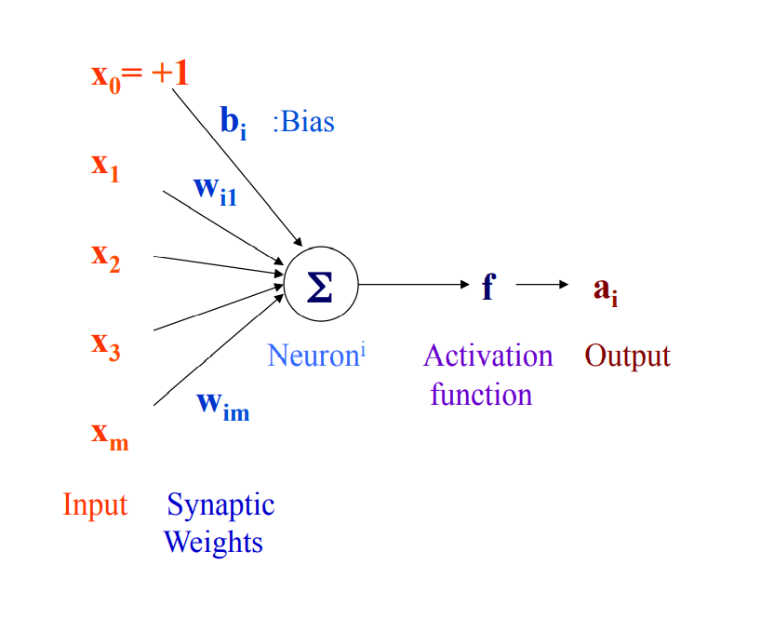
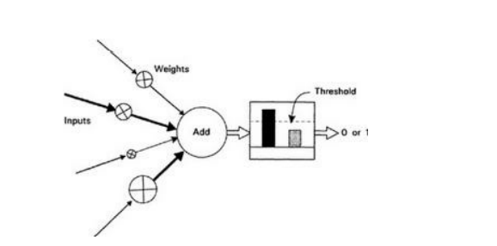
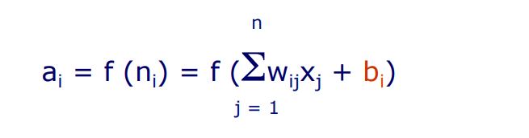

Artificial Neuron

Slide 42
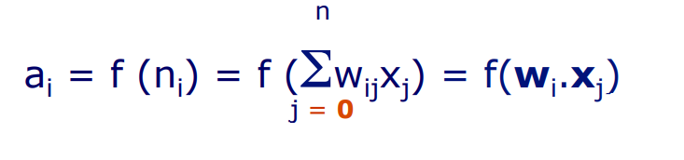
An artificial neuron
- computes the weighted sum of its input (called its net input)
- adds its bias
- passes this value through an activation function
We say that the neuron “fires” (i.e. becomes active) if its output is above zero.
Bias can be incorporated as another weight clamped to a fixed input of +1.0
This extra free variable (bias) makes the neuron more powerful

Slide 43
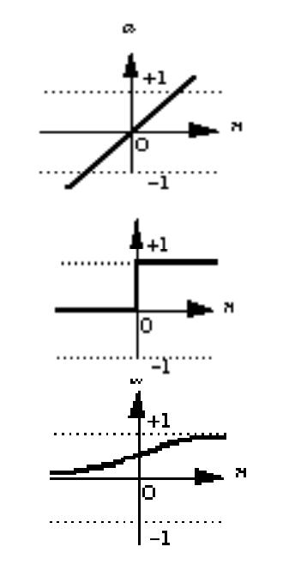
Activation functions
Also called the squashing function as it limits the amplitude of the output of the neuron.
Many types of activations functions are used:
– linear: a = f(n) = n
– threshold: a = {1 if n >= 0
0 if n < 0
– sigmoid: a = 1/(1+e-n)

Slide 44
Artificial Neural Network
A neural network is a massively parallel, distributed processor made up of simple processing units (artificial neurons).
It resembles the brain in two respects:
– Knowledge is acquired by the network from its environment through a learning process
– Synaptic connection strengths among neurons are used to store the acquired knowledge.

Slide 45
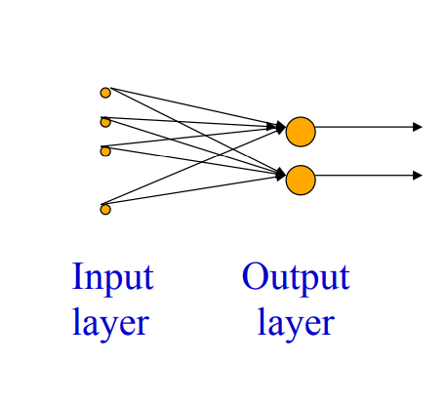
Single layer Feed Forward Network

Slide 46
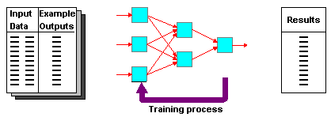
Supervised Learning
Learning Algorithm
While epoch produces an error
Present network with next inputs from epoch
Error = T – O
If Error <> 0 then
W_{j} = W_{j} +/- LR * W_{j} *Error
End If
End While

Slide 47
Parameters
Epoch : Presentation of the entire training set to the neural network.
Target Value, T : When we are training a network we not only present it with the input but also with a value that we require the network to produce.
Output , O : The output value from the neuron
Ij : Inputs being presented to the neuron
Wj : Weight from input neuron (I_{j}) to the output neuron
LR : The learning rate. This dictates how quickly the network converges. It is set by a matter of experimentation. It is typically 0.1
Error: The error value is the amount by which the value output by the network differs from the target value. For example, if we required the network to output 0 and it output a 1, then Error = -1

Slide 48
-1
For AND
A B Output
0 0 0
0 1 0
1 0 0
1 1 1
W₁ = 0.3
x
t = 0.0
W₂ = 0.5
W₃ =-0.4
y

Slide 49
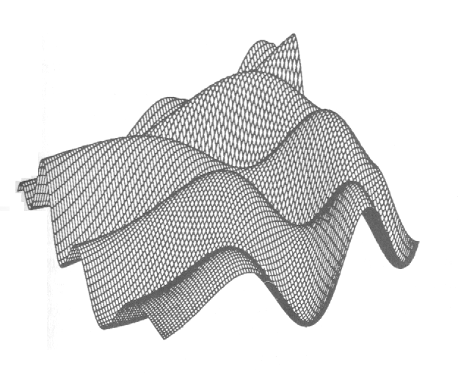
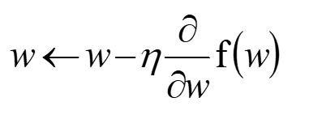
Learning- backpropagation
Training the Network - Learning
Backpropagation
Requires training set (input / output pairs)
Starts with small random weights
Error is used to adjust weights (supervised learning)
Gradient descent on error landscape
We want to find a local minimum.
Assume our current weight is w
GRADIENT DESCENT RULE:
η is called the LEARNING RATE. A small positive number, e.g. η = 0.05

Slide 50
Backpropagation Convergence
Convergence to a global minimum is not guaranteed.
In practice, this is not a problem, apparently.
Tweaking to find the right number of hidden units, or a useful learning rate η, is more hassle, apparently.
Learning rate:
Too small: can take days instead of minutes to converge
Too large: diverges (MSE gets larger and larger while the weights increase and usually oscillate)

Slide 51
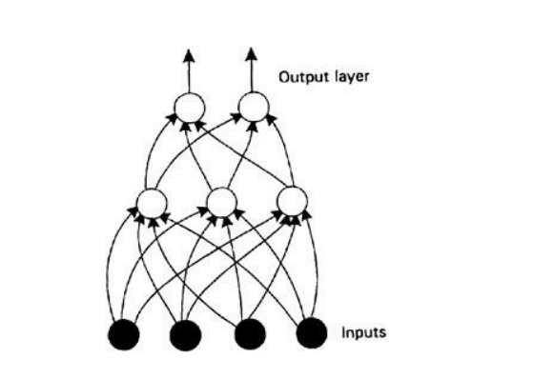
Multi Layered Neural Network
This feedforward structure is only one of several available and is typically used to place an input pattern into one of several classes according to the resulting pattern of outputs.z
This feedforward structure is only one of several available and is typically used to place an input pattern into one of several classes according to the resulting pattern of outputs.

Slide 52
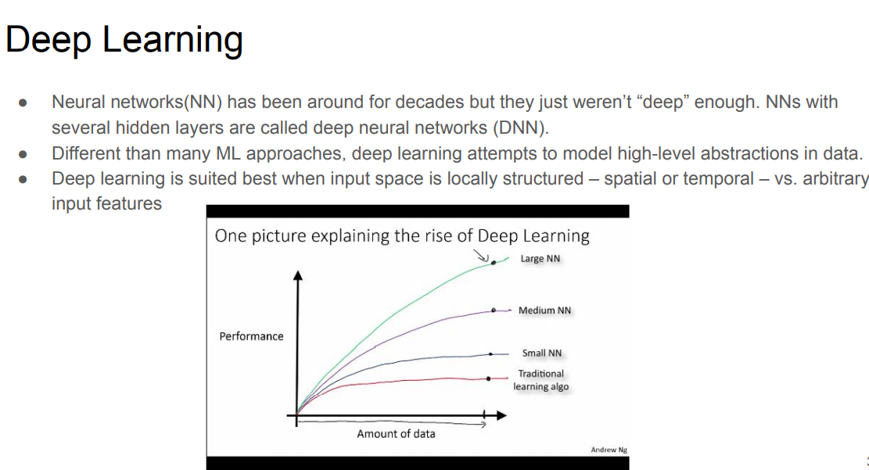

Slide 53
Definition of Deep Learning
Deep Learning is a class of machine learning in the form of a neural network that uses a cascade of layers of processing units to extract the features from the data and make the predictive guesses about new data.

Slide 54
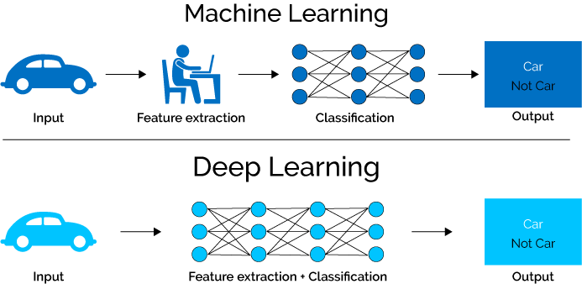
What is Deep Learning (DL) ?
A machine learning subfield of learning representations of data. Exceptional effective at learning patterns.
Deep learning algorithms attempt to learn (multiple levels of) representation by using a hierarchy of multiple layers
If you provide the system tons of information, it begins to understand it and respond in useful ways.

Slide 55
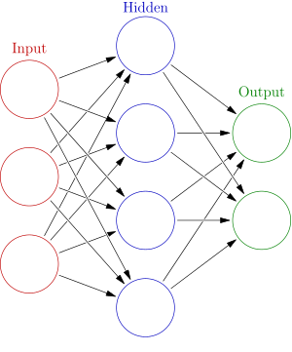





Deep Neural Network
Weights
$$h= σ(W_{1}x+b_{1})$$
$$y=σ(W_{2}h+b_{2})$$
Activation functions
How do we train?
$$y$$
$$x$$
4 + 2 = 6 neurons (not counting inputs)
[3 x 4] + [4 x 2] = 20 weights
4 + 2 = 6 biases
26 learnable parameters
$$h$$
Demo

Slide 56
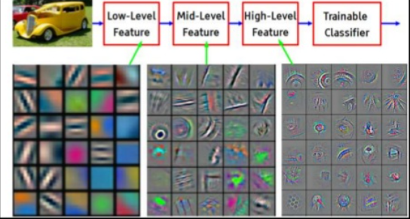

Slide 57
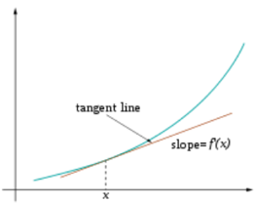
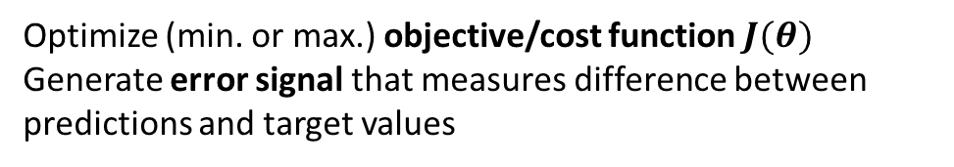
Training
Sample labeled data
(batch)
Forward it through the network, get predictions
Back-propagate the errors
Update the network weights
Optimize (min. or max.) objective/cost function $J(θ)$
Generate error signal that measures difference between predictions and target values
Use error signal to change the weights and get more accurate predictions
Subtracting a fraction of the gradient moves you towards the (local) minimum of the cost function

Slide 58
Kinds of Deep Neural Nets
Convolutional Neural Nets:
Image Recognition
Convolve: rollup to higher levels of abstraction in feature sets
Recurrent Neural Nets:
Speech, text, audio recognition
Recur: iterate over sequential inputs with memory function
LSTM(Long Short term Memory) remembers sequences and avoids gradient vanishing

